Slide 1
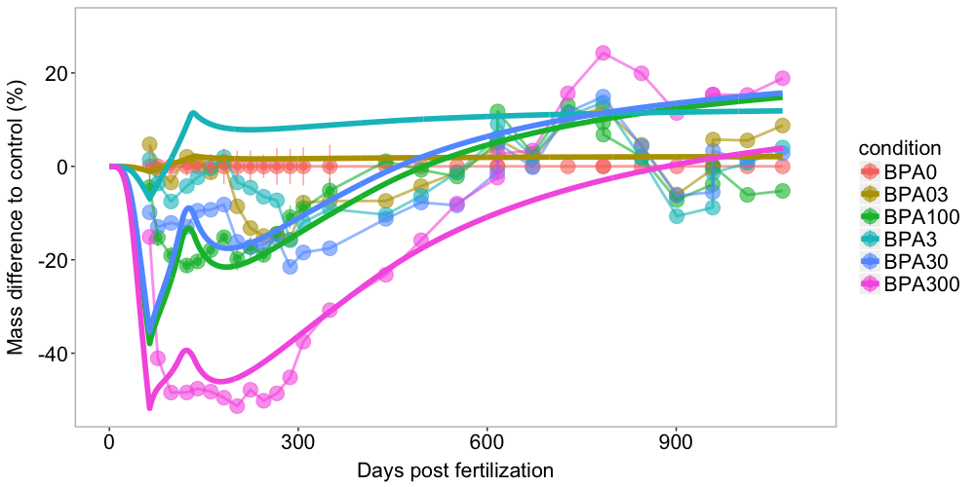
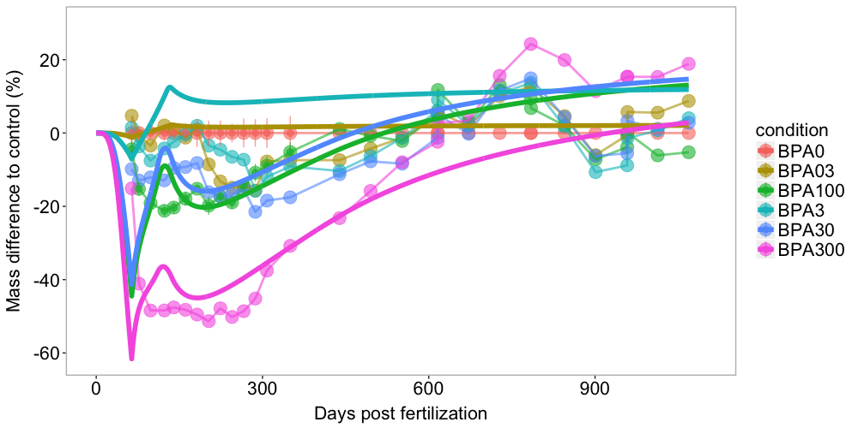
param_spring_damper = c(ks = 0.9364505, cs = 111.3815455, Fpert_BPA03 = -0.2883765, Fpert_BPA3 = 2,
Fpert_BPA30 = 13.6921932 , Fpert_BPA300 = 25.0945938, Fpert_BPA100 = 15.1185264)
Acc_after_64dpf =TRUE
MoA = "E.G”
Acc_after_64dpf =FALSE

Slide 2
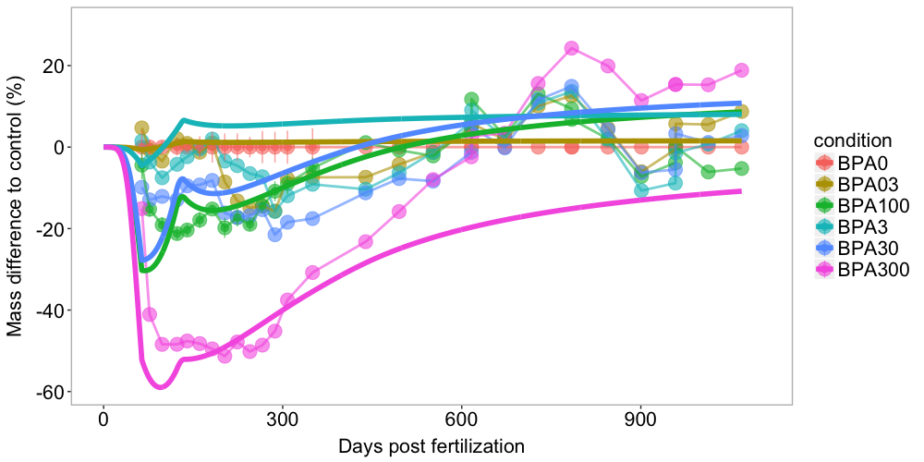
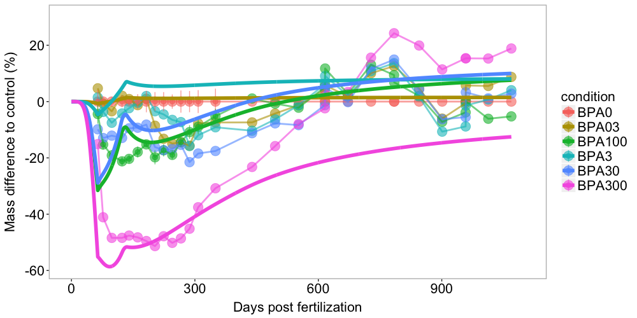
param_spring_damper = c(ks = 0.9364505, cs = 60, Fpert_BPA03 = -0.2883765, Fpert_BPA3 = 2,
Fpert_BPA30 = 13.6921932 , Fpert_BPA300 = 30, Fpert_BPA100 = 15.1185264)
Acc_after_64dpf =TRUE
MoA = ”p.M”
Acc_after_64dpf =FALSE

Slide 3
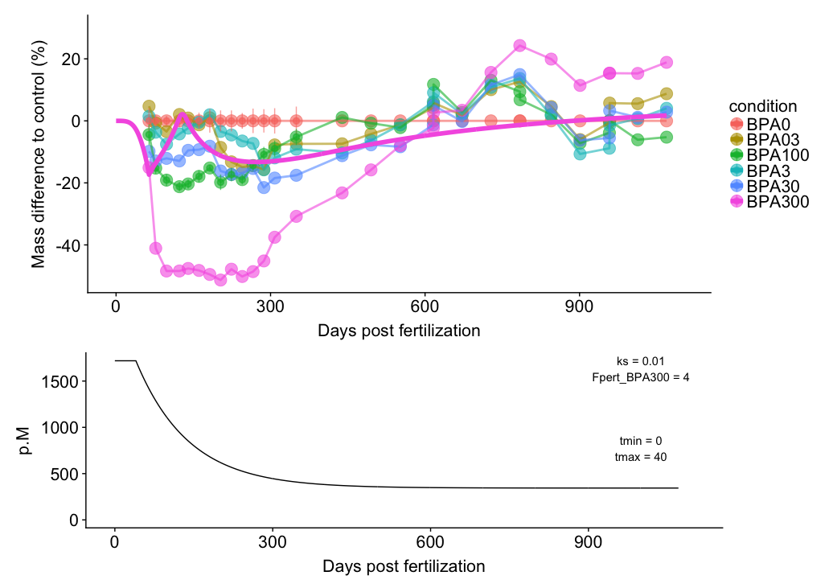
MoA = p.M and exponential decrease

Slide 4
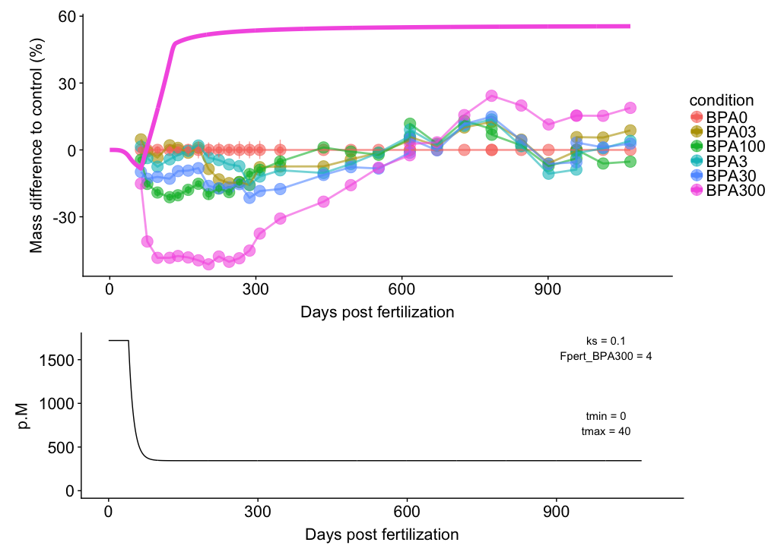

Slide 6
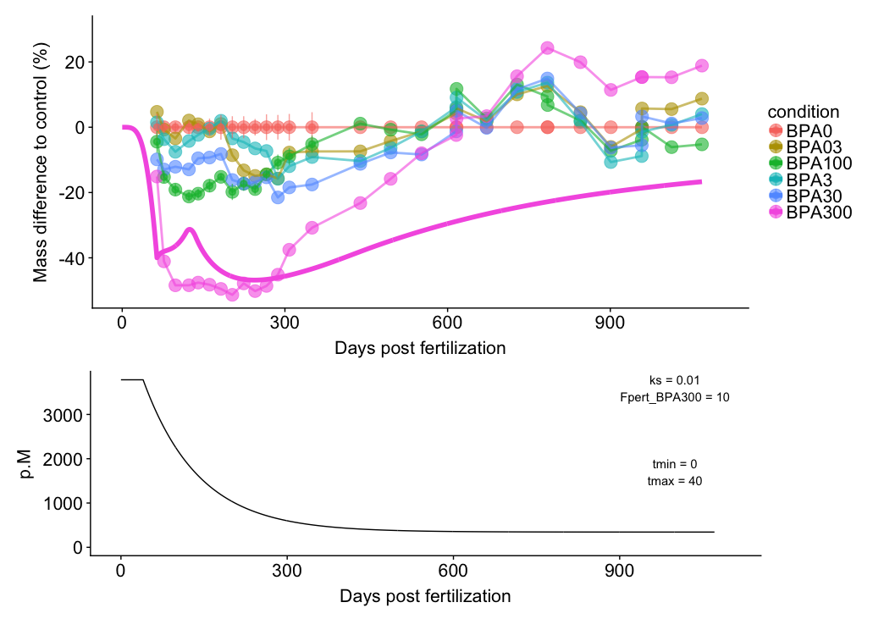

Slide 7
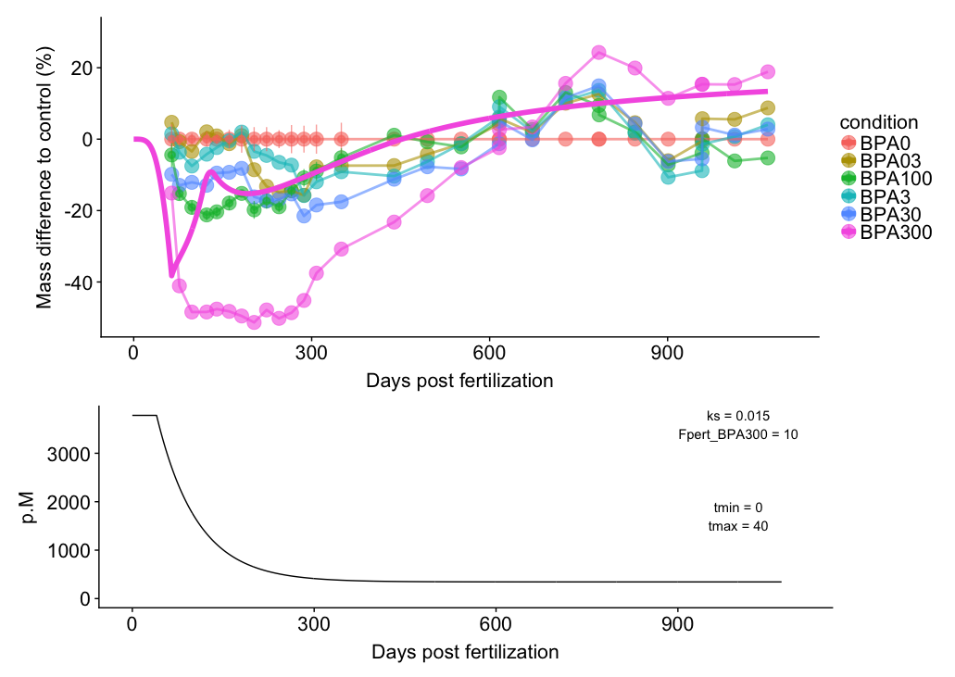

Slide 8
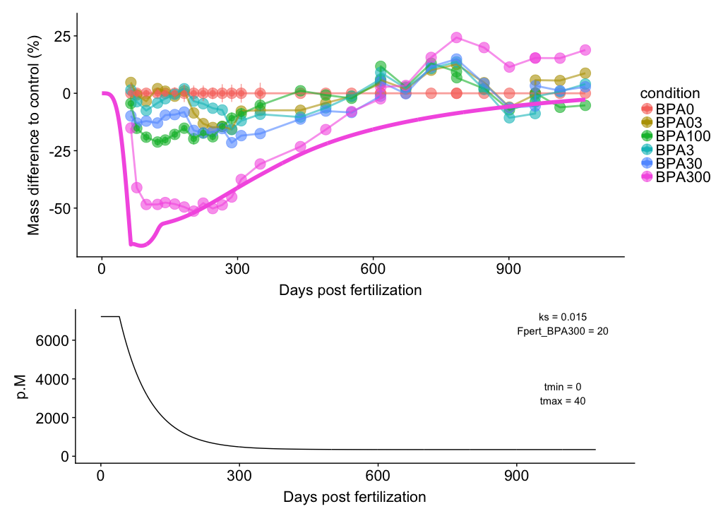

Slide 9
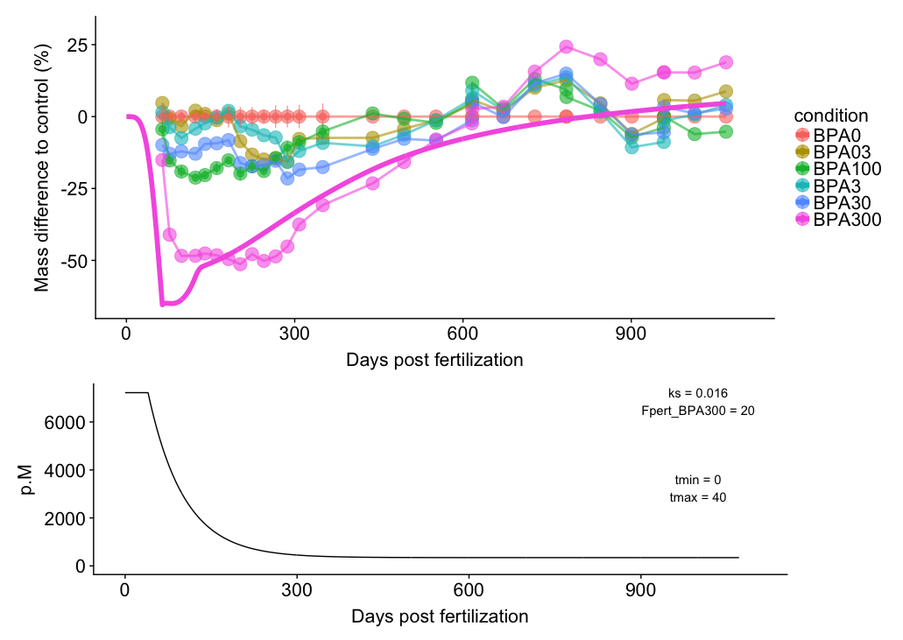

Slide 10
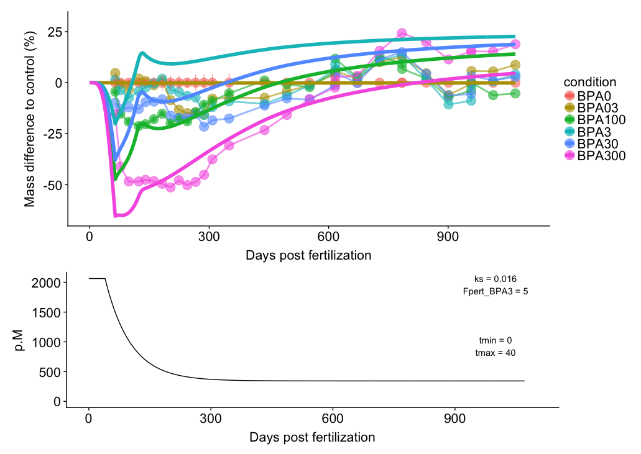
Notes:
param_spring_damper = c(ks = 0.016, cs = 8, Fpert_BPA03 = 0, Fpert_BPA3 = 5,
Fpert_BPA30 = 10, Fpert_BPA300 = 20, Fpert_BPA100 = 13)
E0 = 643.562
L0 = 0.0001

Slide 11
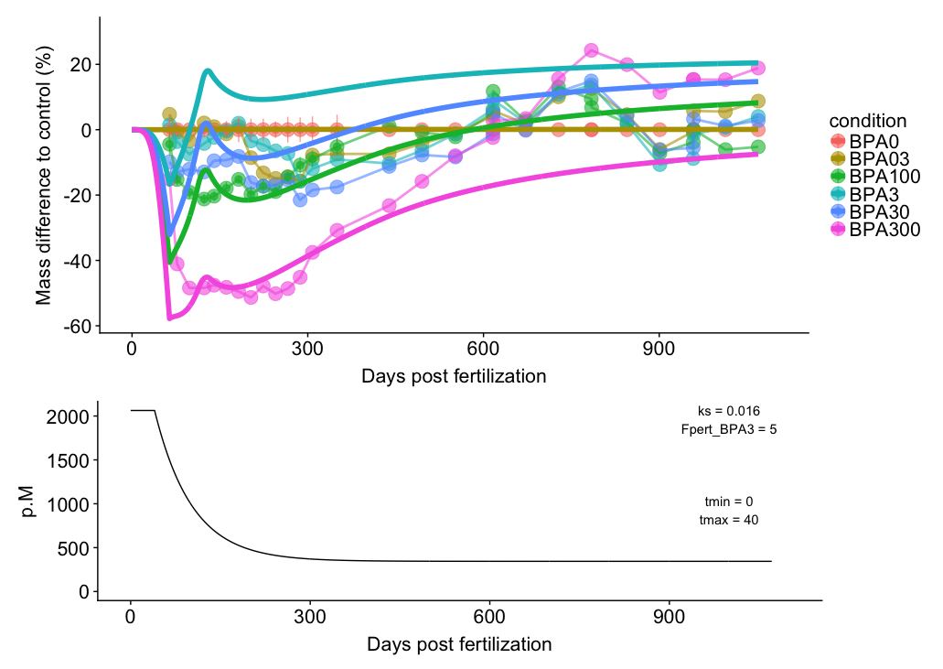
E0 = 800
Notes:
param_spring_damper = c(ks = 0.016, cs = 8, Fpert_BPA03 = 0, Fpert_BPA3 = 5,
Fpert_BPA30 = 10, Fpert_BPA300 = 20, Fpert_BPA100 = 13)

Slide 12
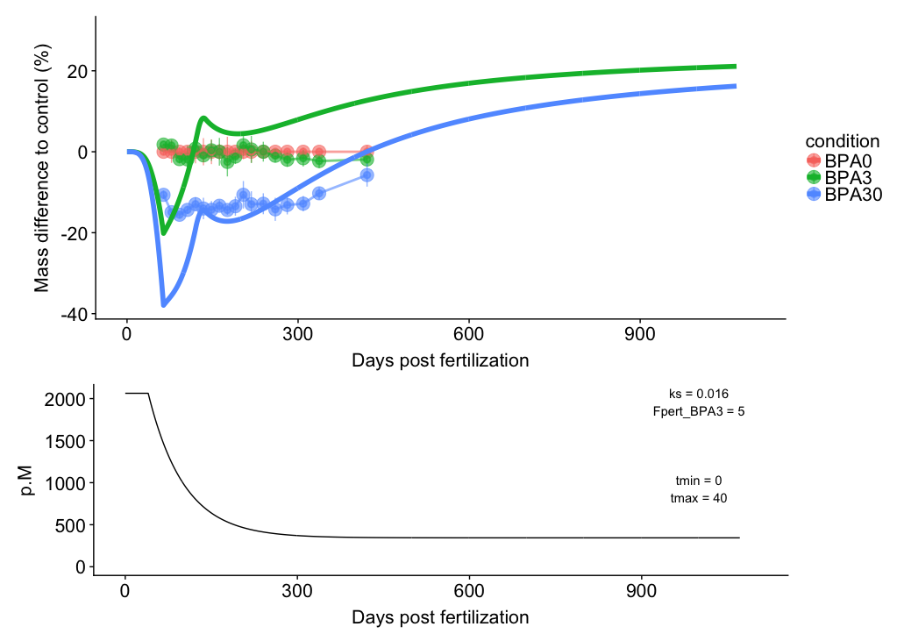

Slide 13
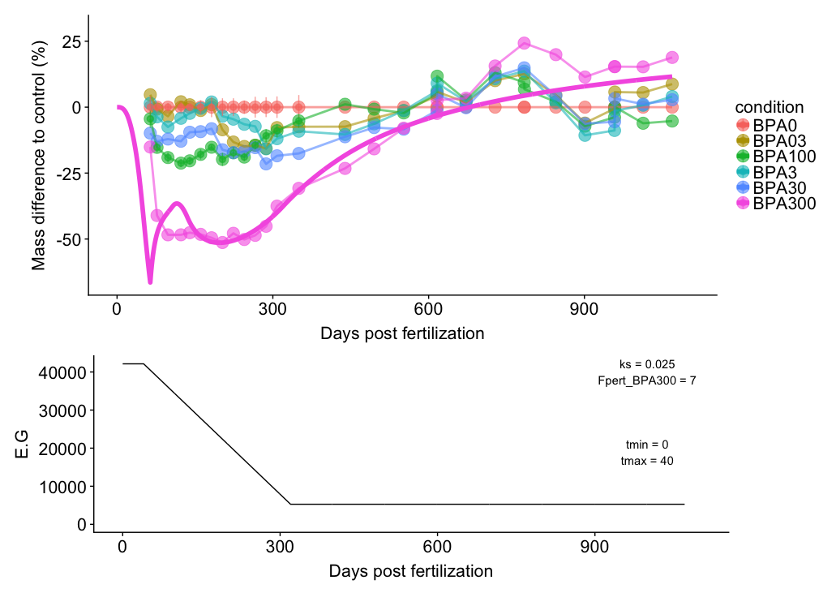
MoA = E.G and linear decrease

Slide 15
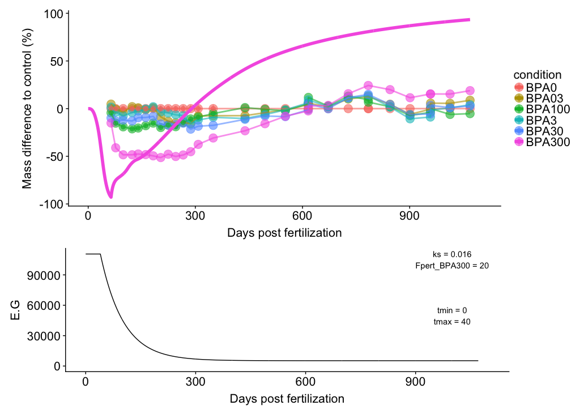
MoA = E.G and exponential decrease

Slide 16
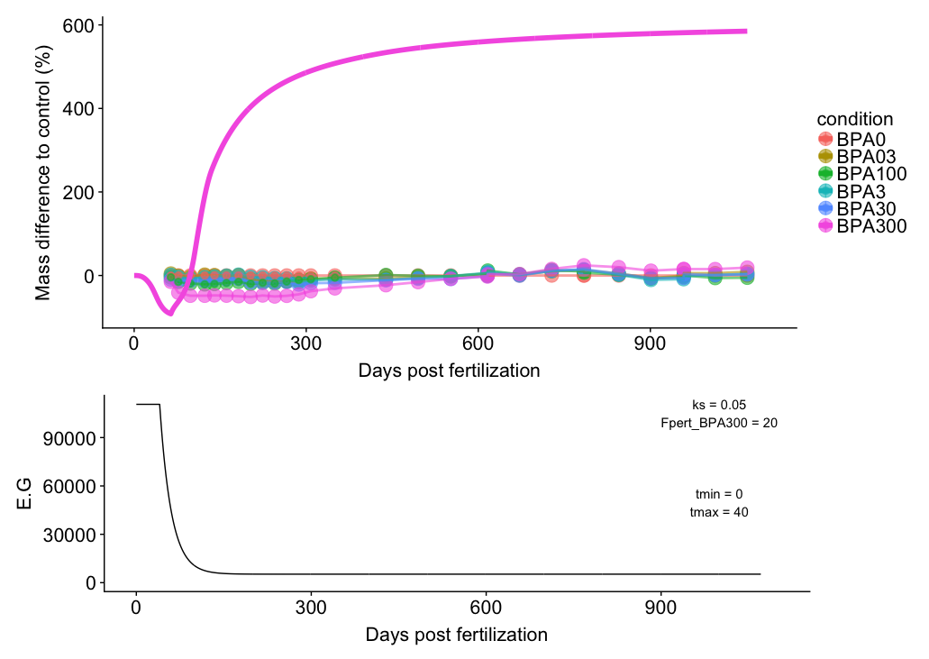

Slide 18
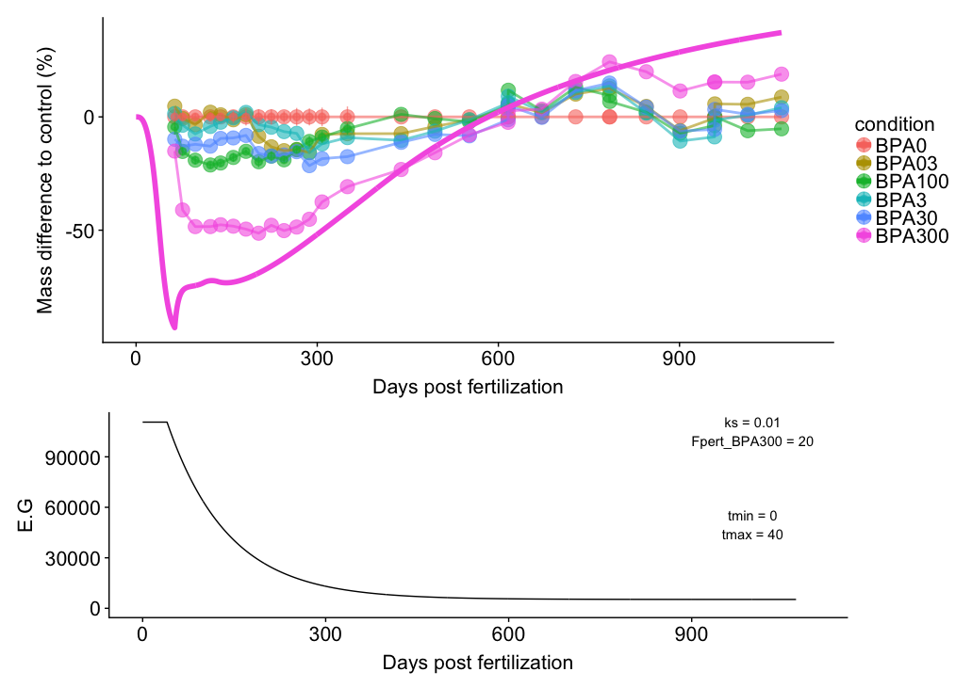

Slide 19
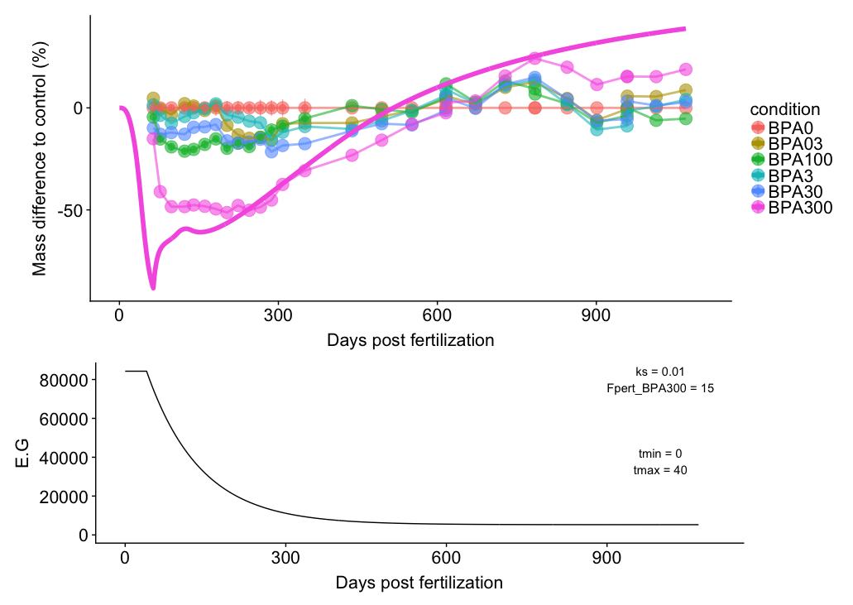

Slide 20
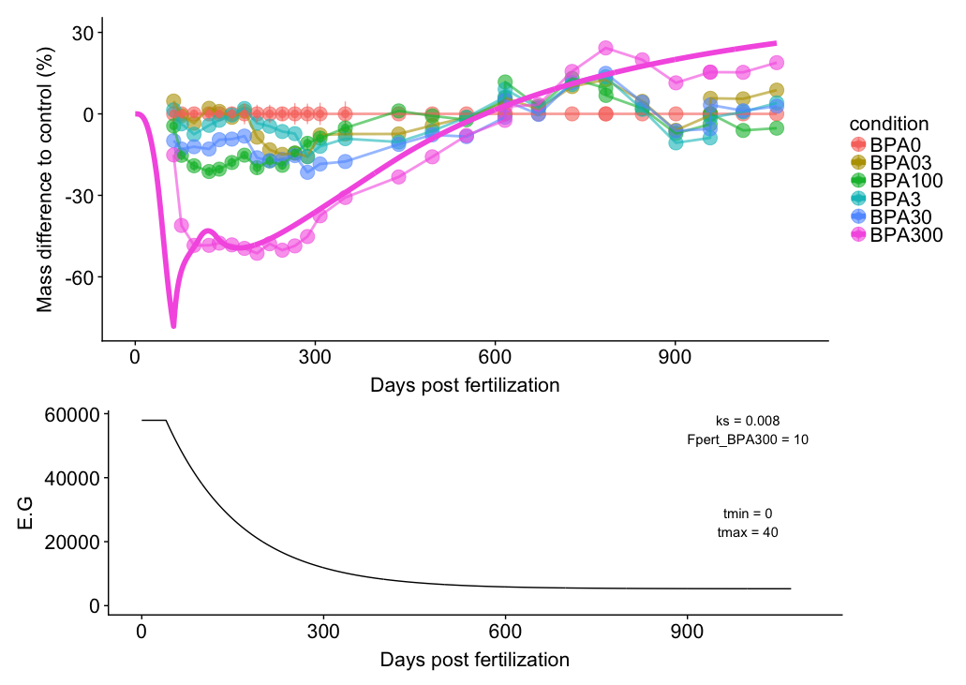

Slide 21
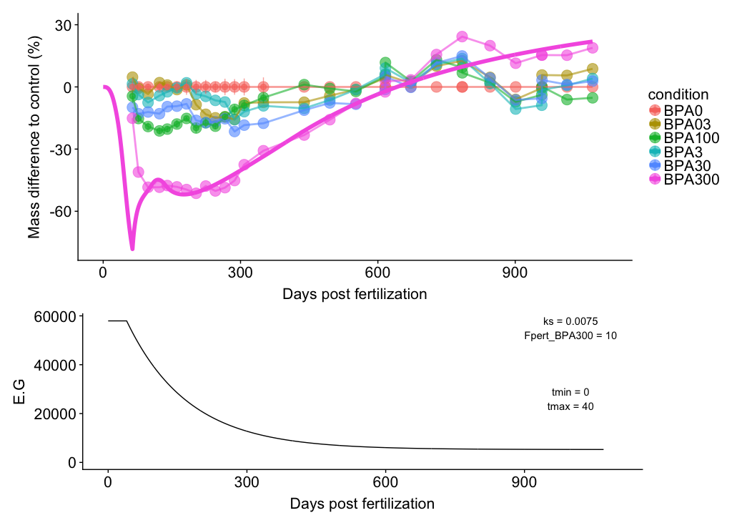

Slide 22
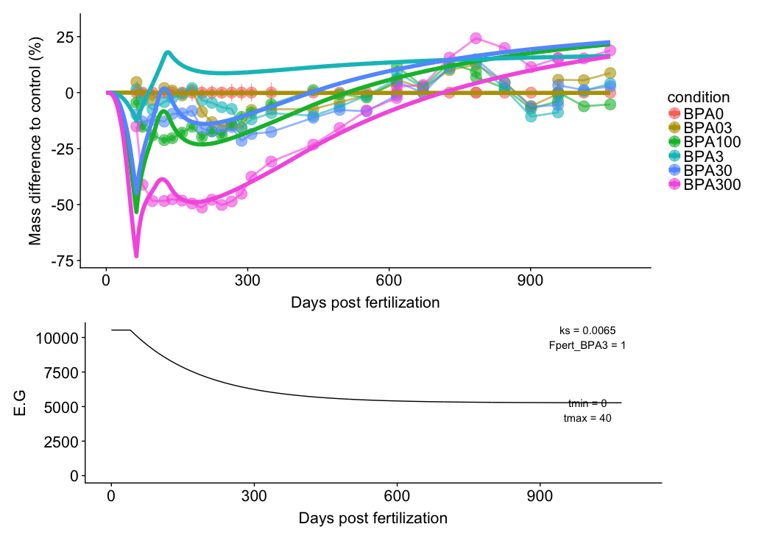
Notes:
param_spring_damper = c(ks = 0.0065, cs = 8, Fpert_BPA03 = 0, Fpert_BPA3 = 1,
Fpert_BPA30 = 4 , Fpert_BPA300 = 8.5, Fpert_BPA100 = 5)

Slide 23
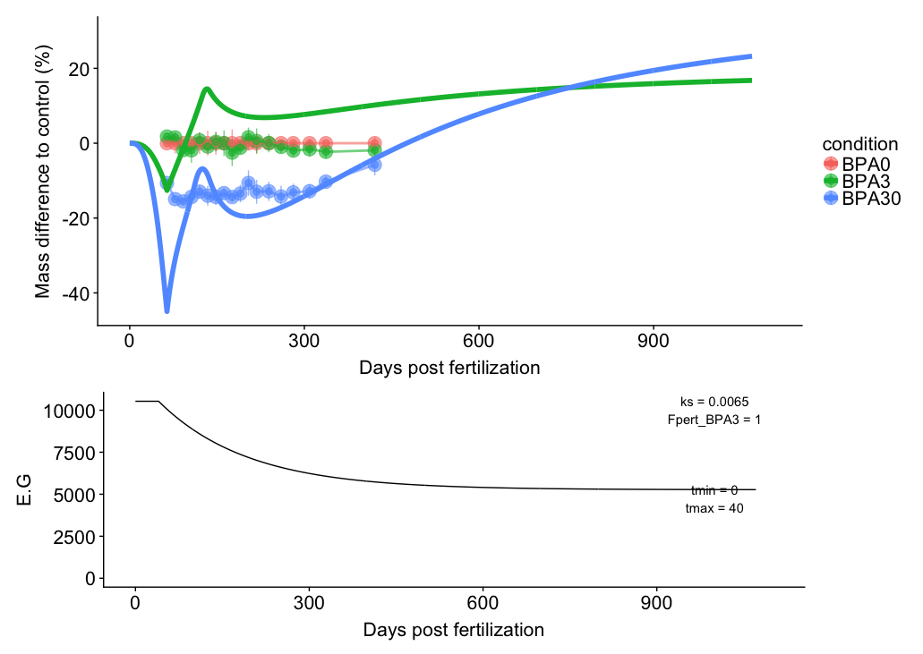
Notes:
param_spring_damper = c(ks = 0.0065, cs = 8, Fpert_BPA03 = 0, Fpert_BPA3 = 1,
Fpert_BPA30 = 4 , Fpert_BPA300 = 8.5, Fpert_BPA100 = 5)

Slide 24
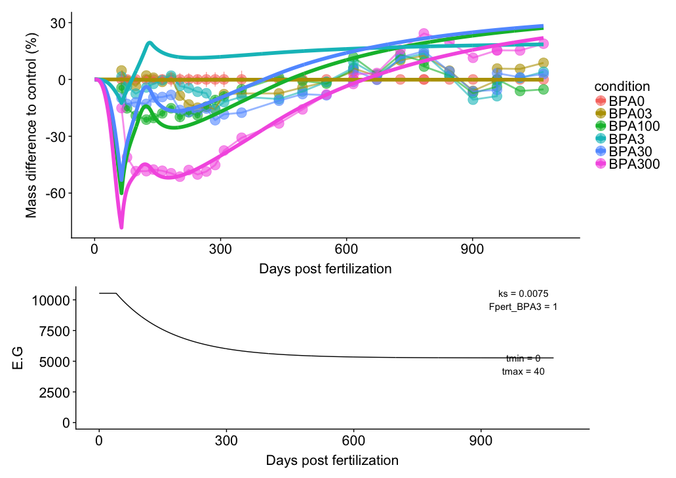
Notes:
param_spring_damper = c(ks = 0.0075, cs = 8, Fpert_BPA03 = 0, Fpert_BPA3 = 1,
Fpert_BPA30 = 5 , Fpert_BPA300 = 10, Fpert_BPA100 = 6)
E0 = 643.562
L0 = 0.0001

Slide 25
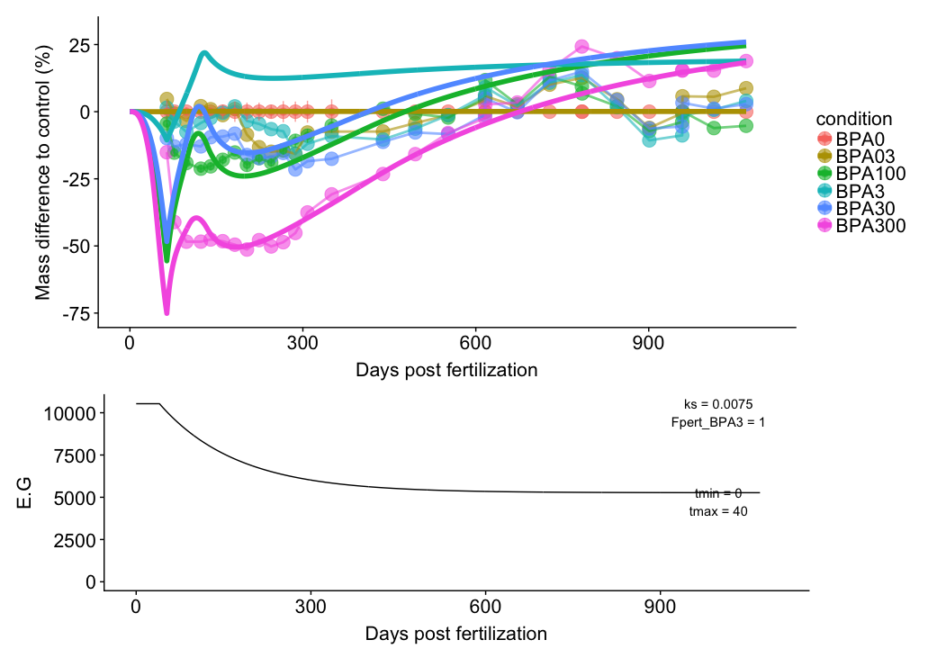
E0 = 800
Notes:
param_spring_damper = c(ks = 0.0075, cs = 8, Fpert_BPA03 = 0, Fpert_BPA3 = 1,
Fpert_BPA30 = 5 , Fpert_BPA300 = 10, Fpert_BPA100 = 6)

Slide 26
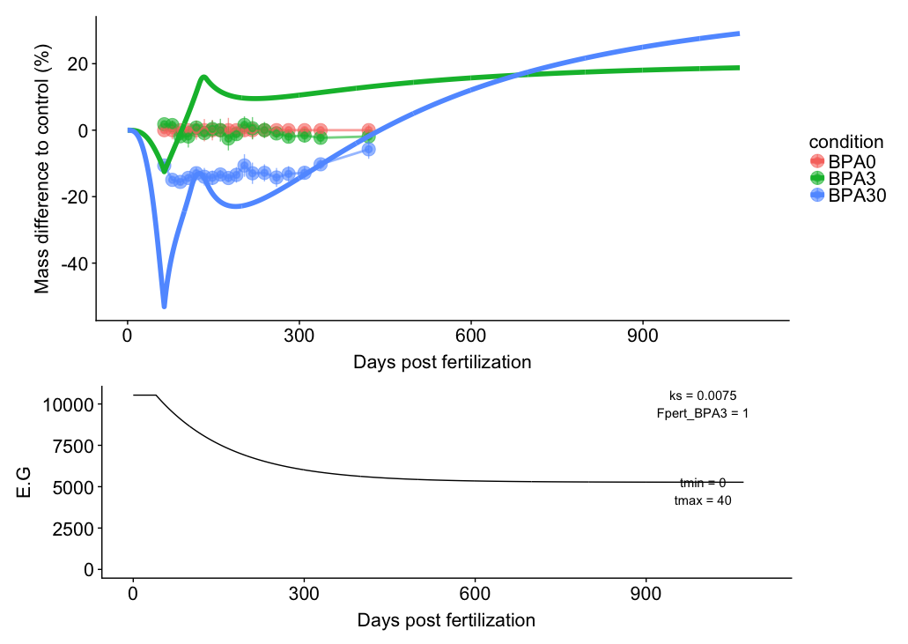

Slide 27
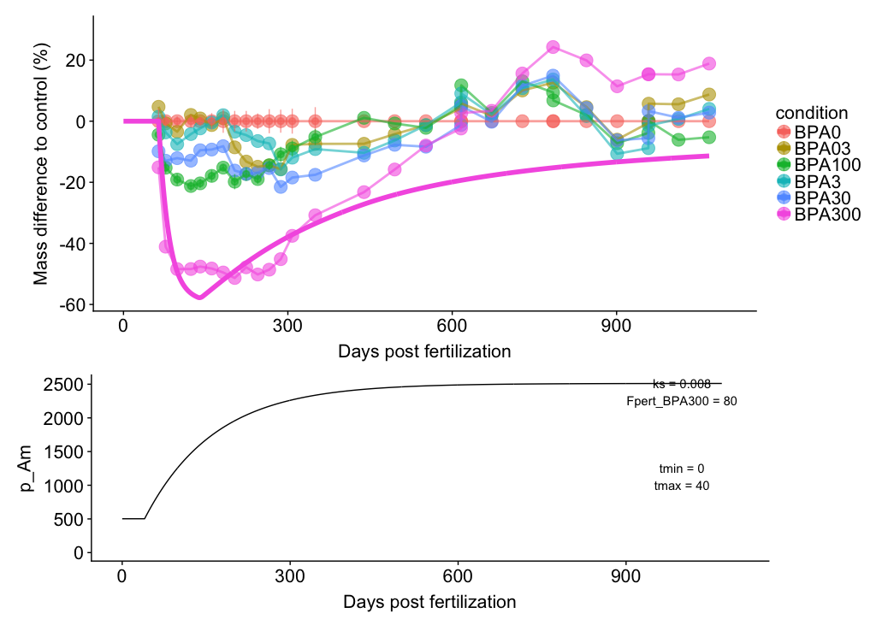
MoA = p_Am and exponential decrease

Slide 29
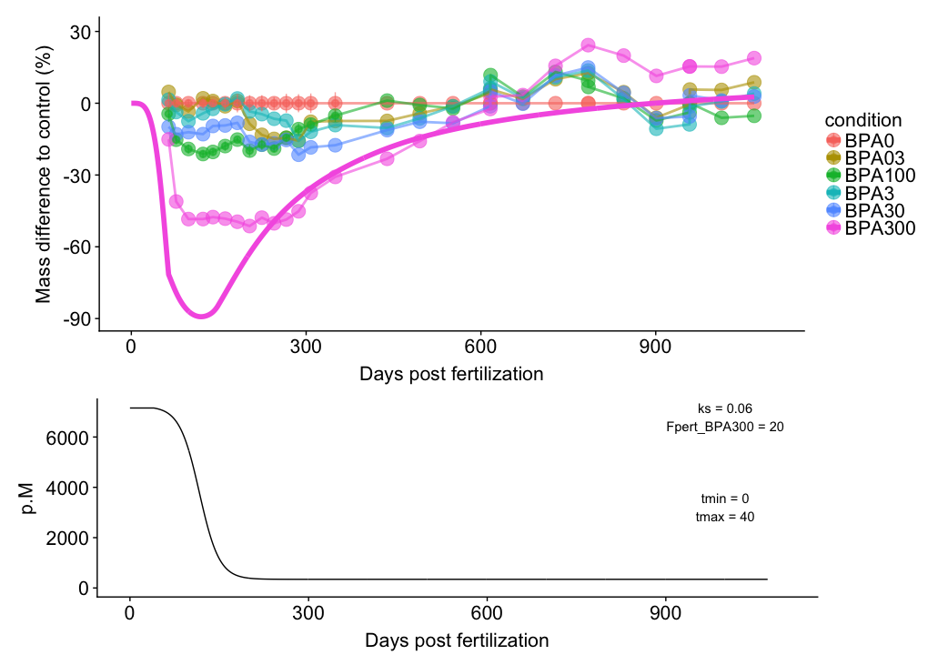
MoA = p.M and logistic decrease

Slide 31
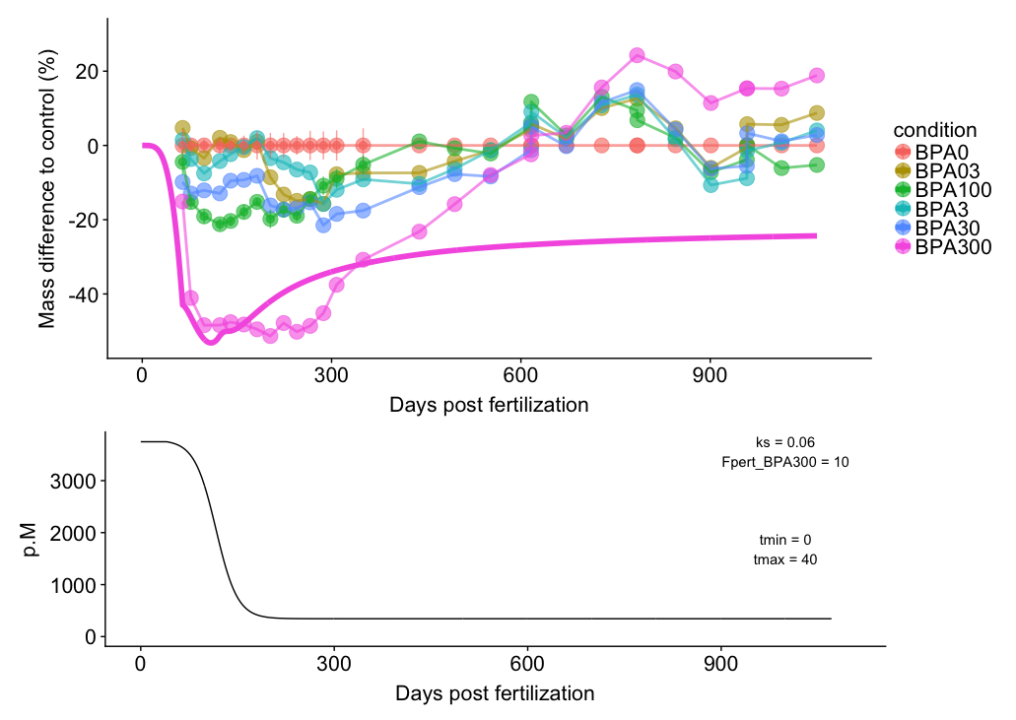

Slide 32
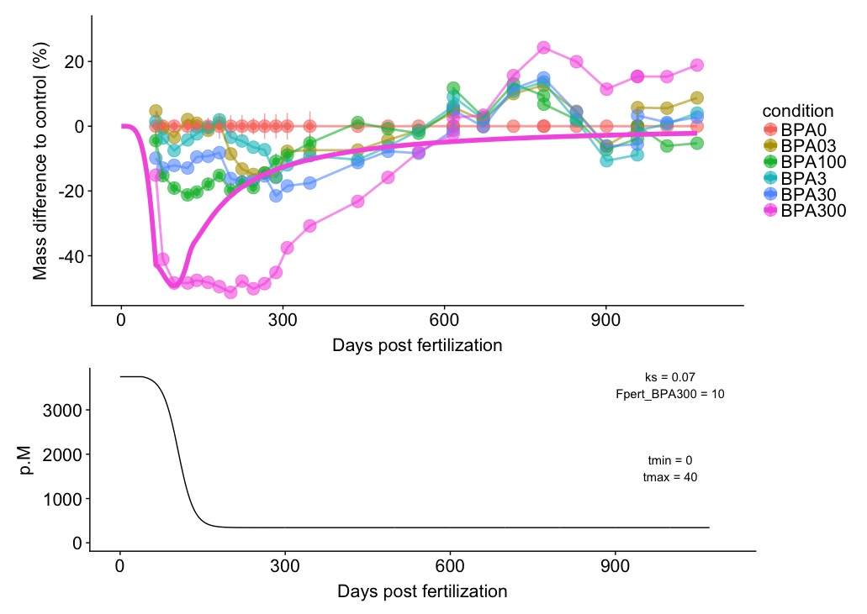

Slide 33
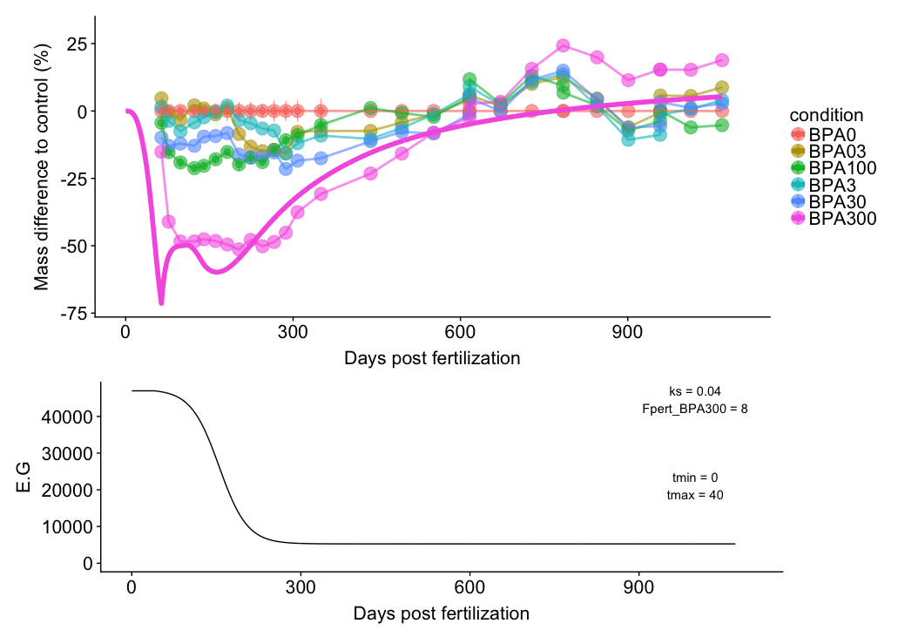
MoA = E.G and logistic decrease

Slide 35
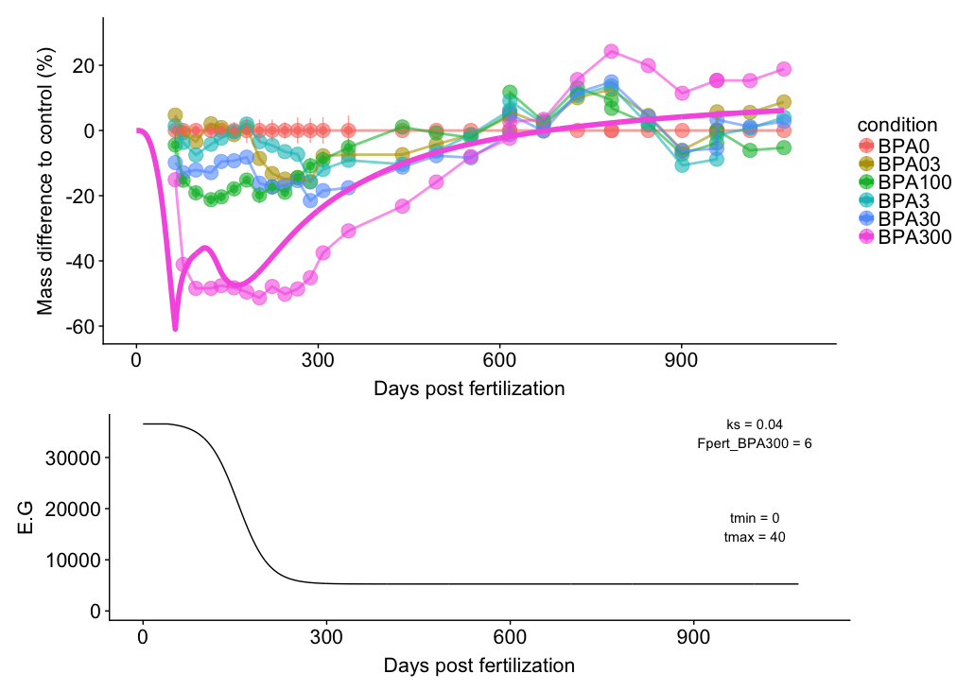

Slide 36
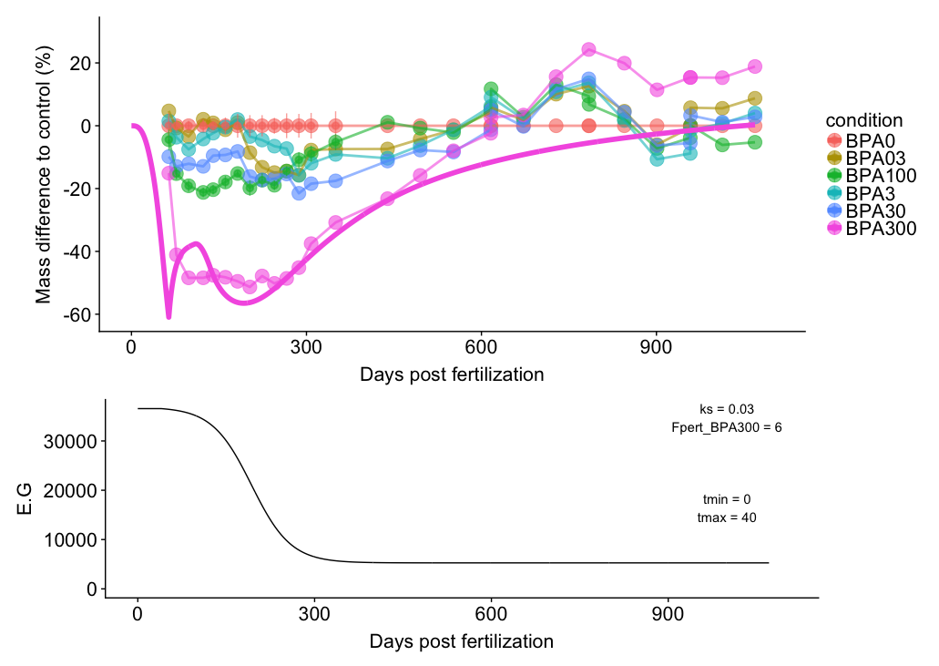

Slide 37
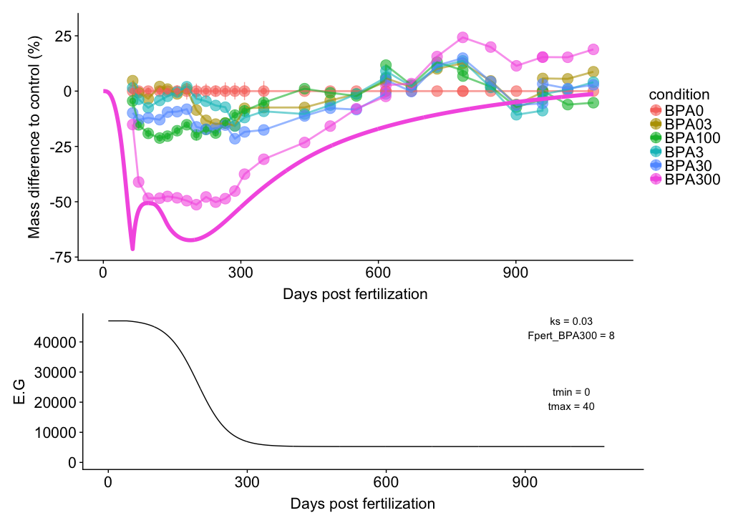

Slide 38
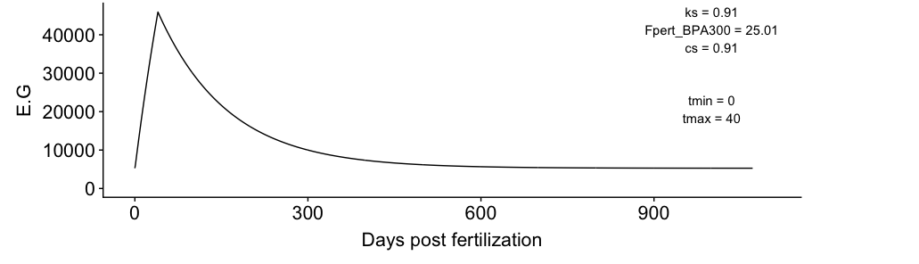
MoA = E.G and spring and damper model

Slide 39
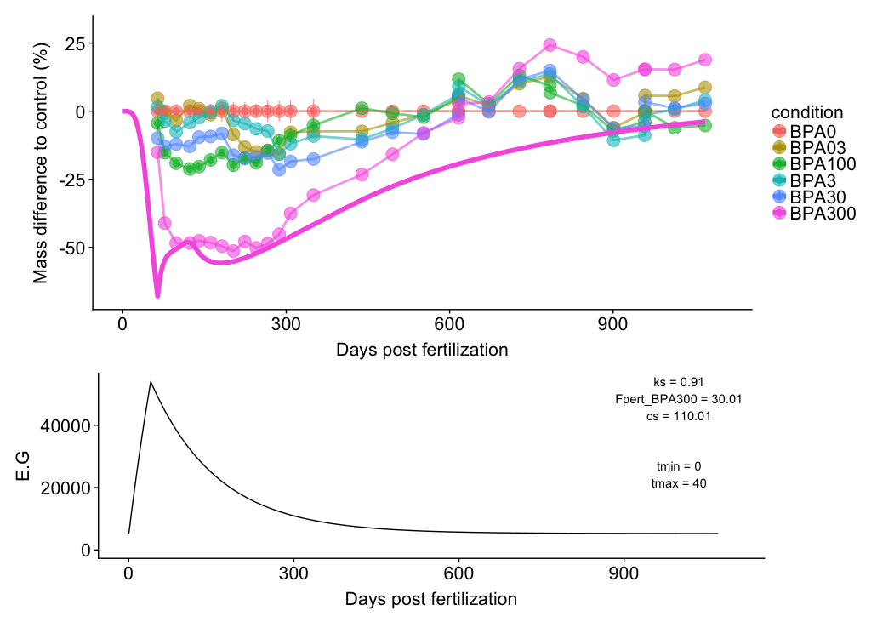

Slide 40


Slide 41
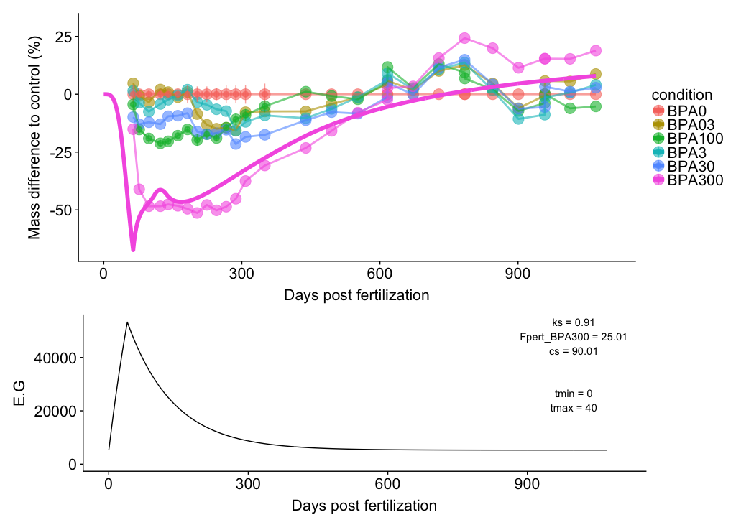

Slide 42
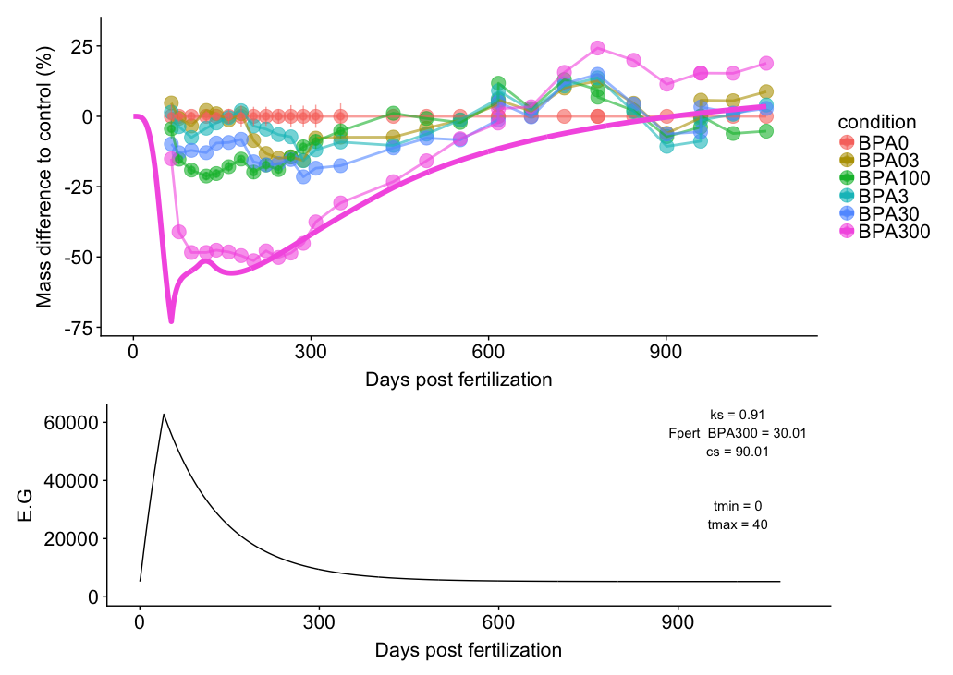

Slide 43
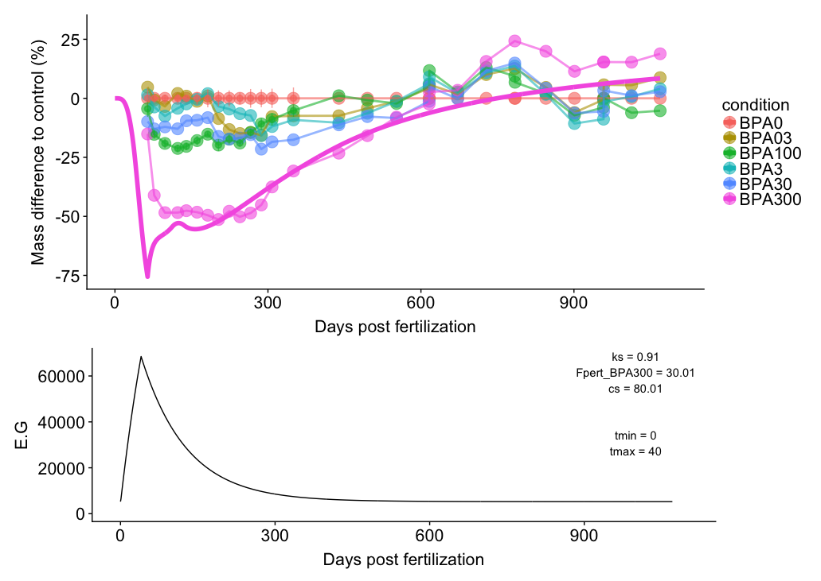

Slide 44


Slide 45
